Slide 1
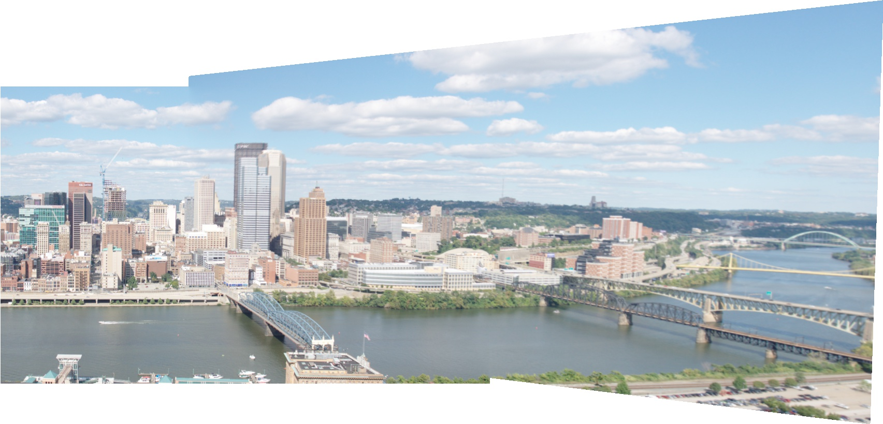
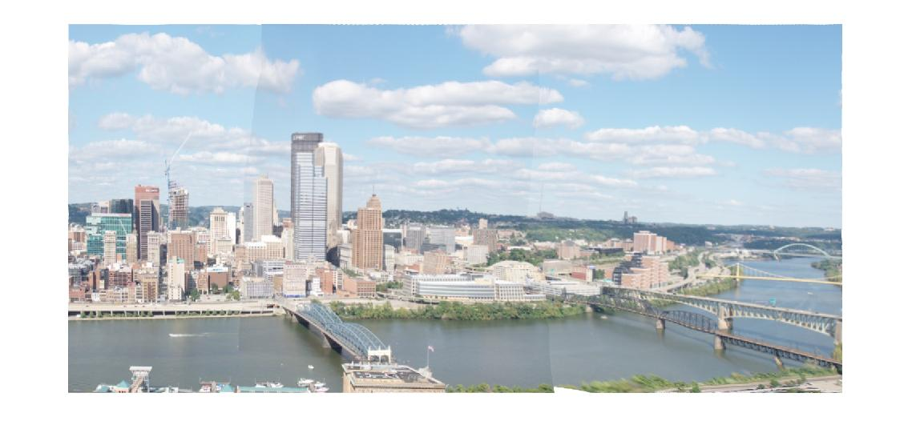
Rectangling Panoramic Images via Warping Overview
stitching result of hw2
after our warping
(a) input (b) local warping via Seam Carving (c) place a grid mesh on local warping result (d) warp backward the grid mesh to the input (e) optimize mesh via global warping

Slide 2
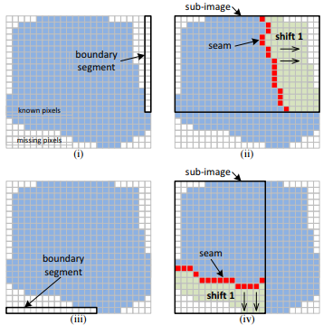
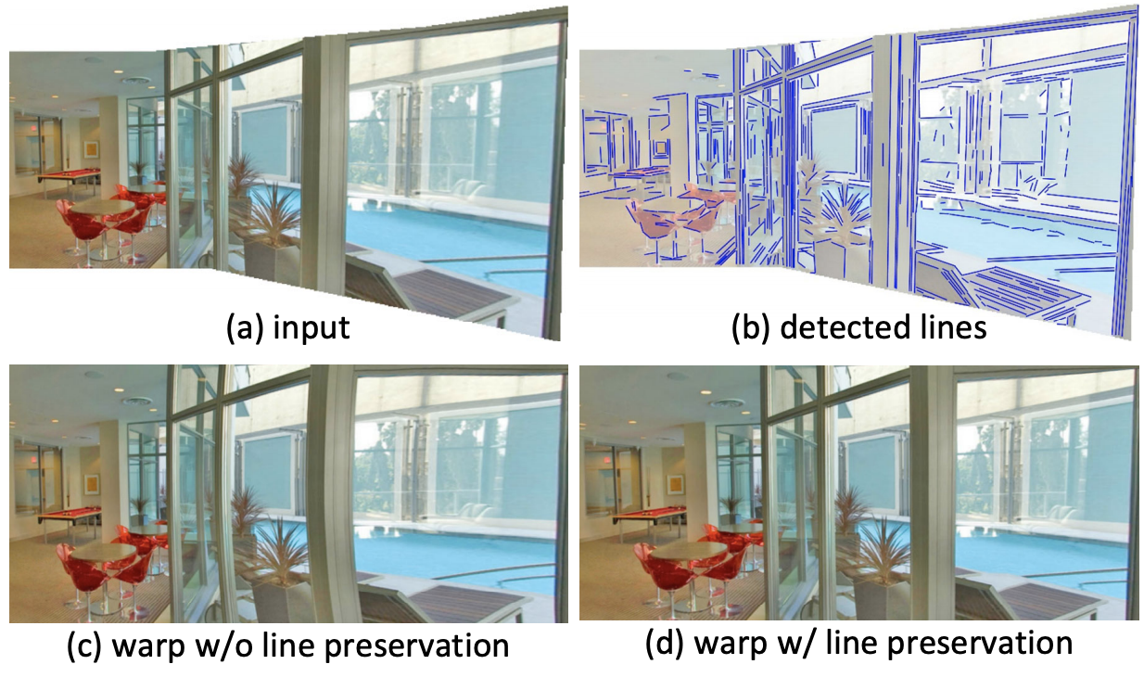
Rectangling Panoramic Images via Warping Two Stage Rectangling
Local Warping by Seam Carving
l
Mesh Based Global Warping
l
Content-aware image resizing for changing the aspect ratio
Insert seams to the original image
Shape Preservation
Line Preservation
Boundary Constraints
Total Energy
(i) find the longest boundary segment
(ii) compute a seam using seam carving
(iii) shift all the pixels
on one side of the seam
by 1 pivel
(iv) repeat until fill the rectangle
Efficient Optimization
(i) Fix and update
(ii) Fix and update

Slide 3
Rectangling Panoramic Images via Warping Demo Video

Slide 4
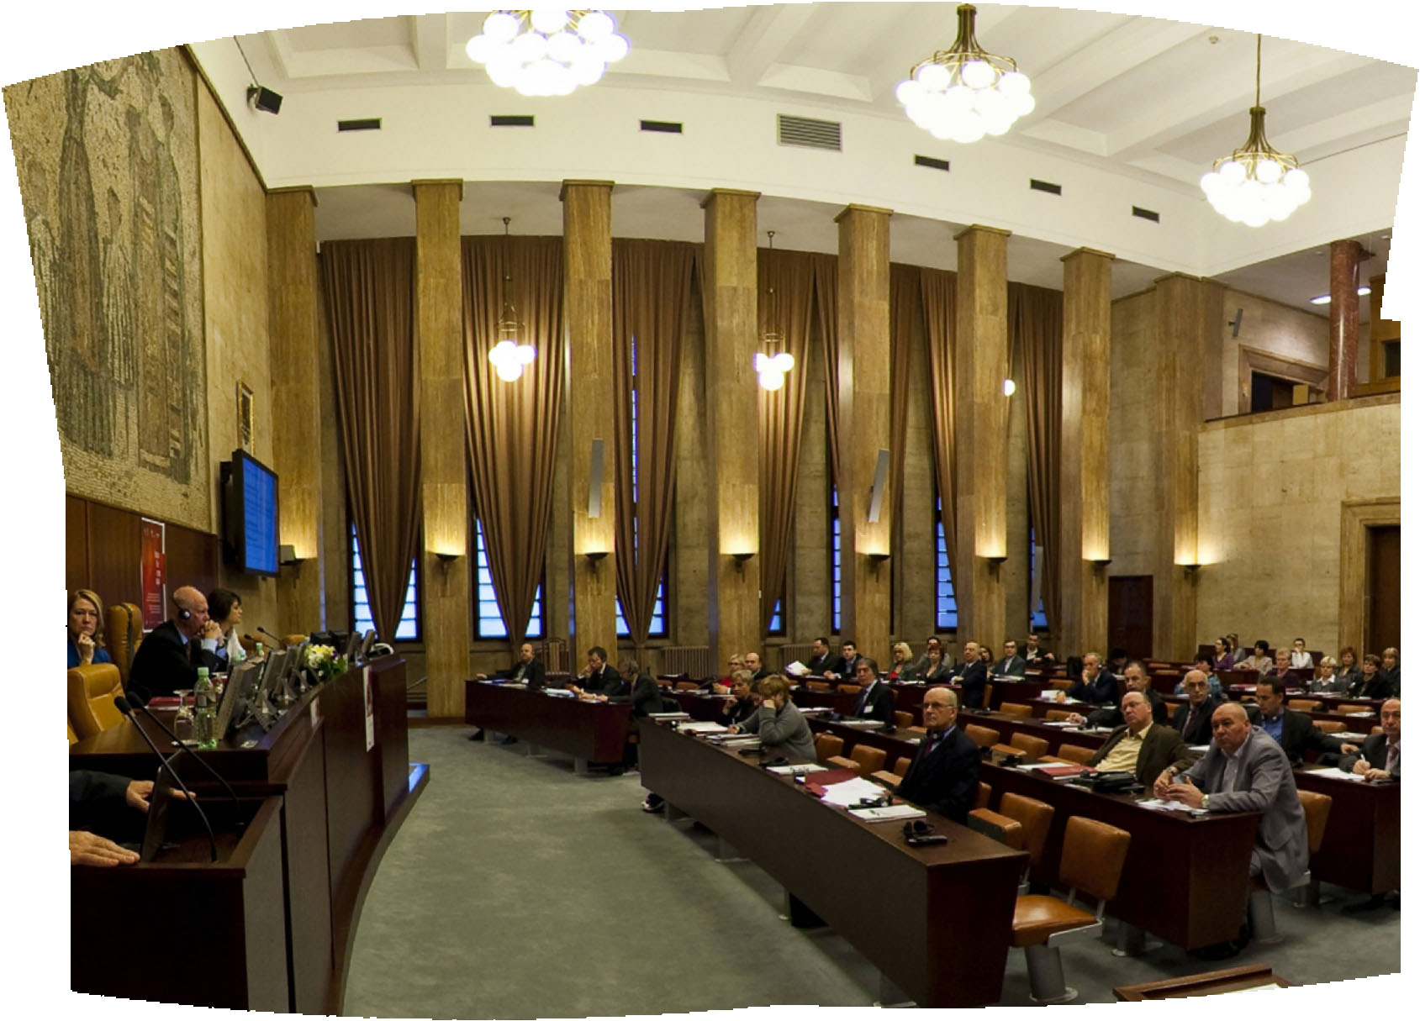
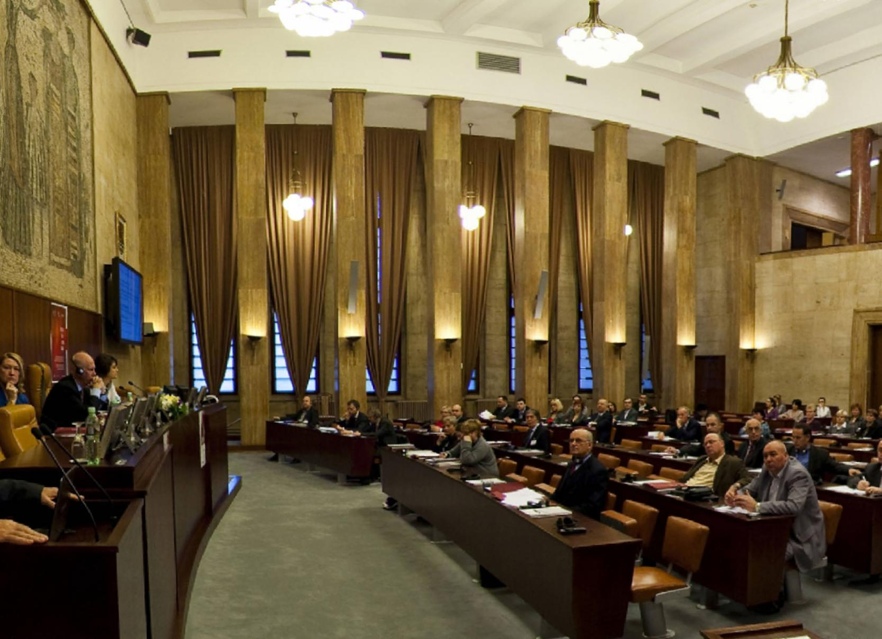
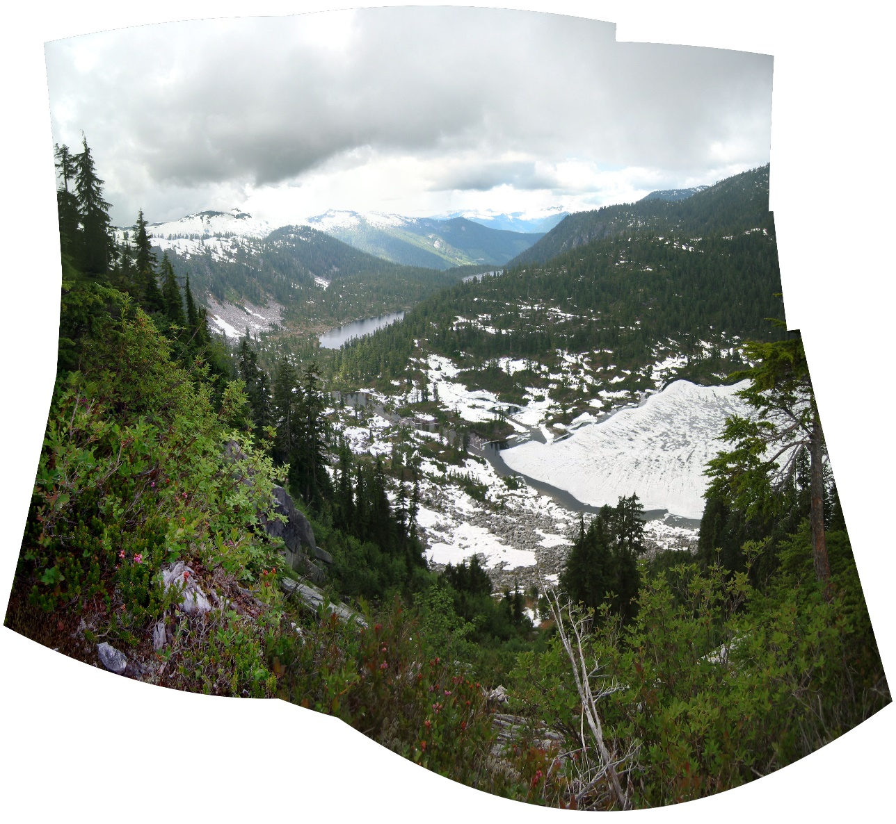
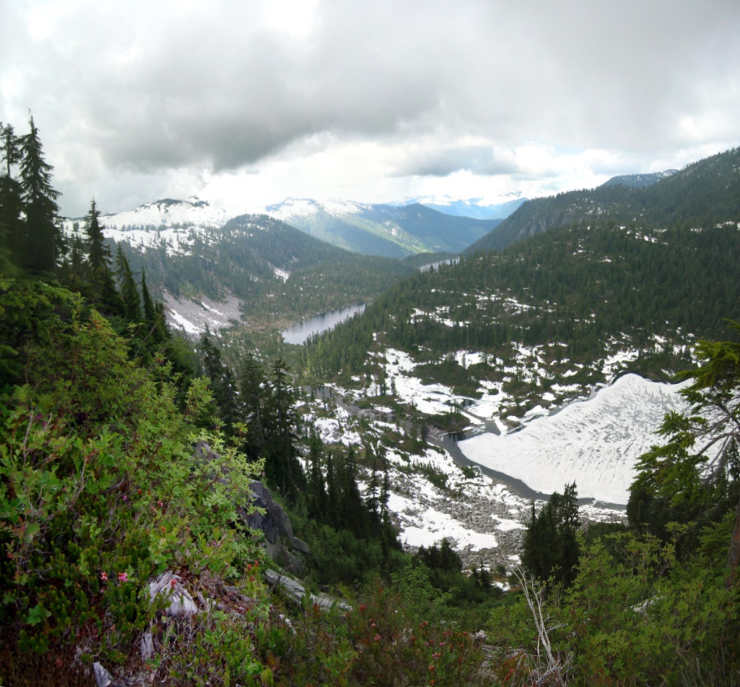
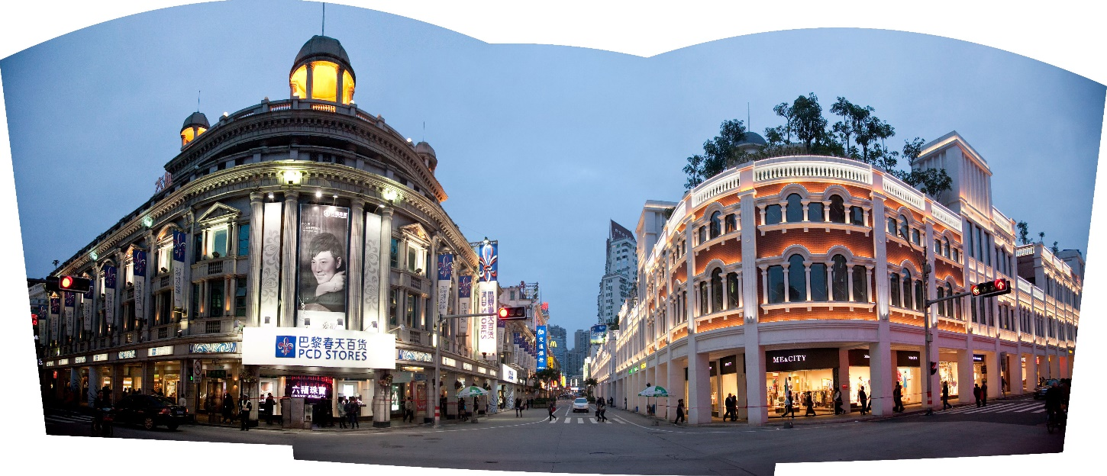
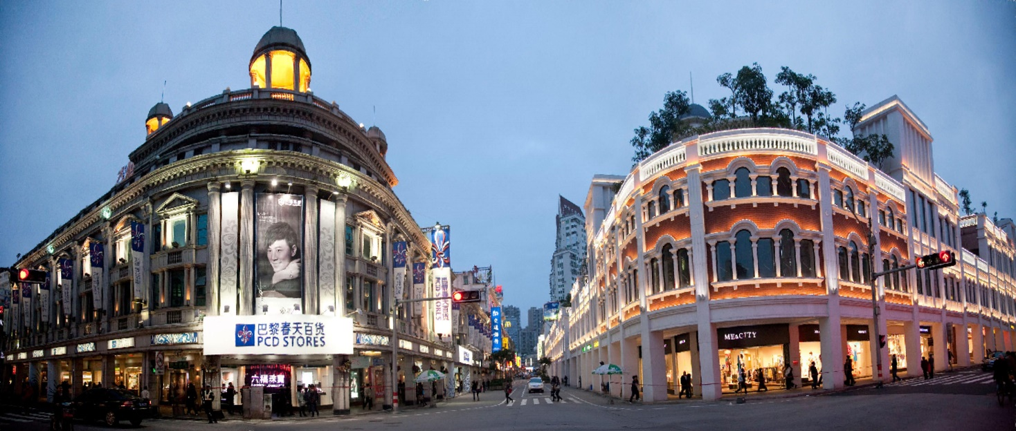
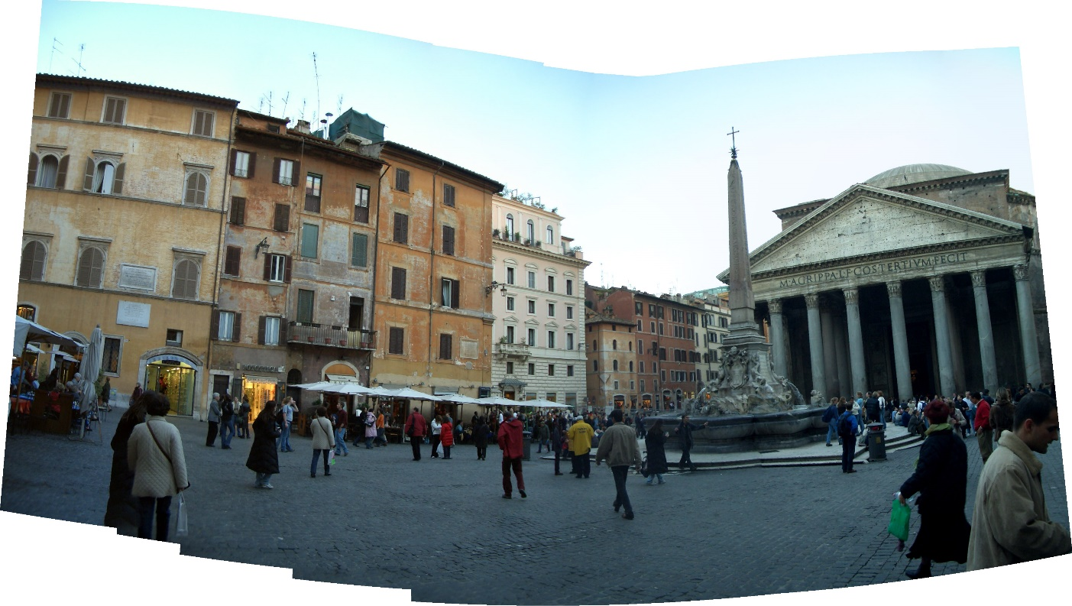
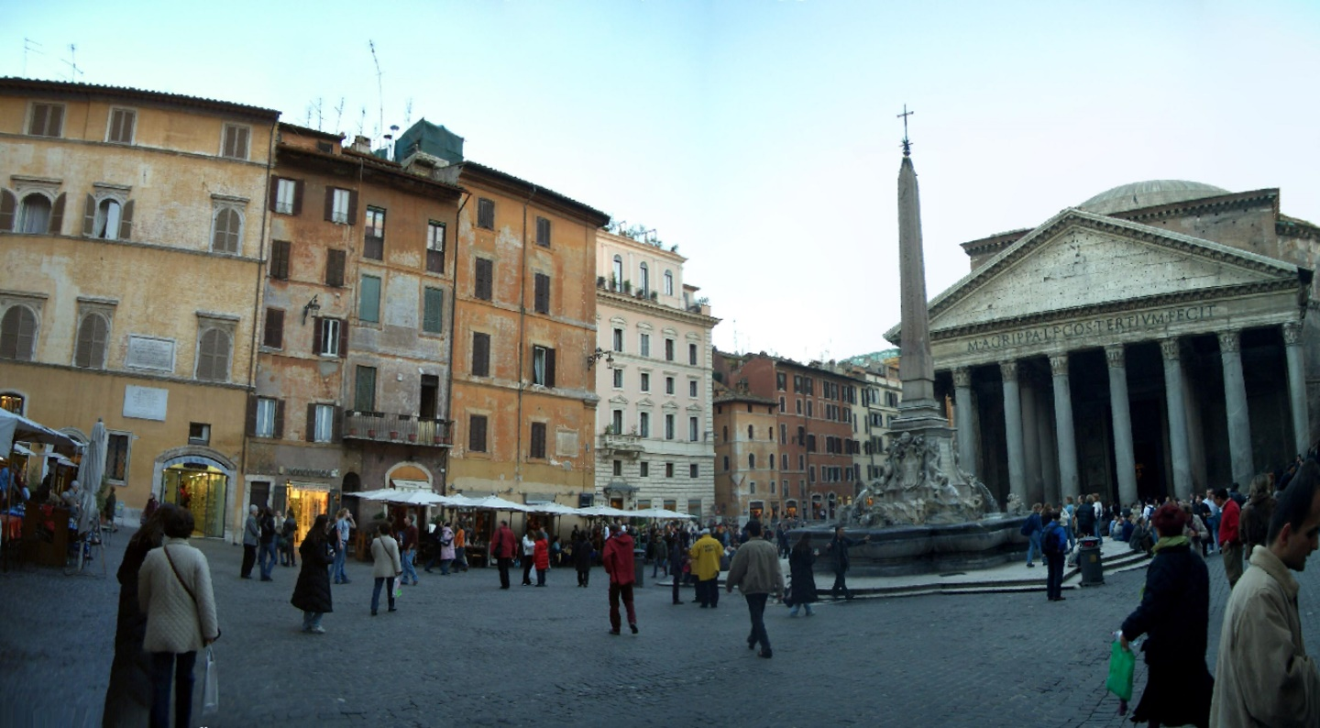
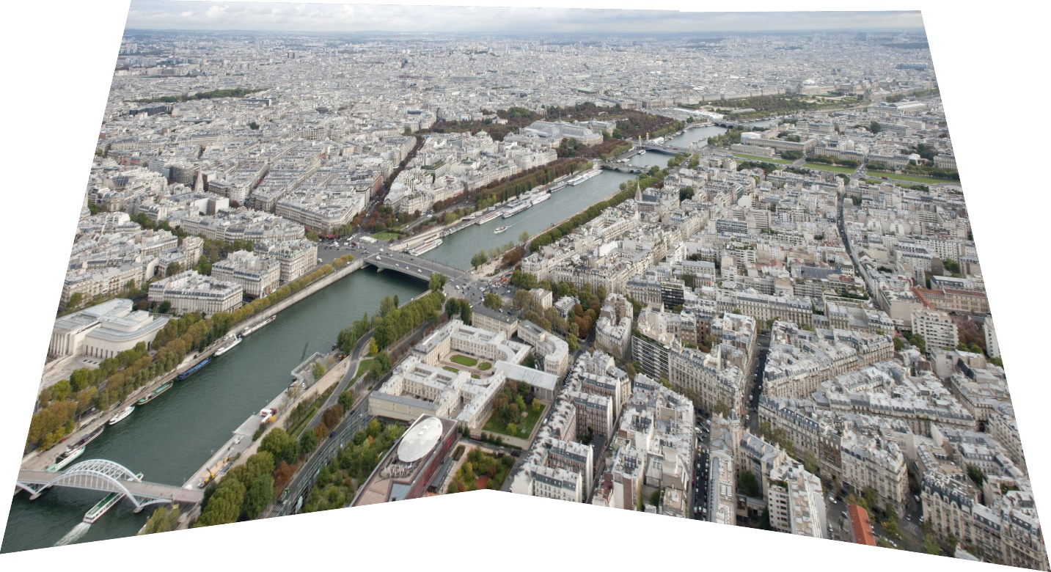
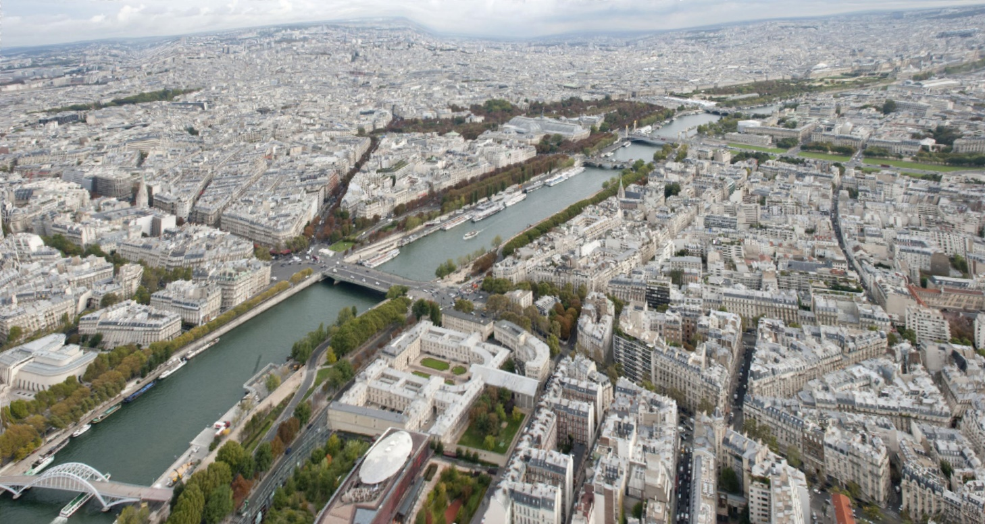
More Results

